Slide 1

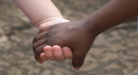


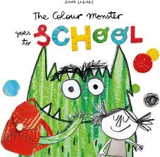
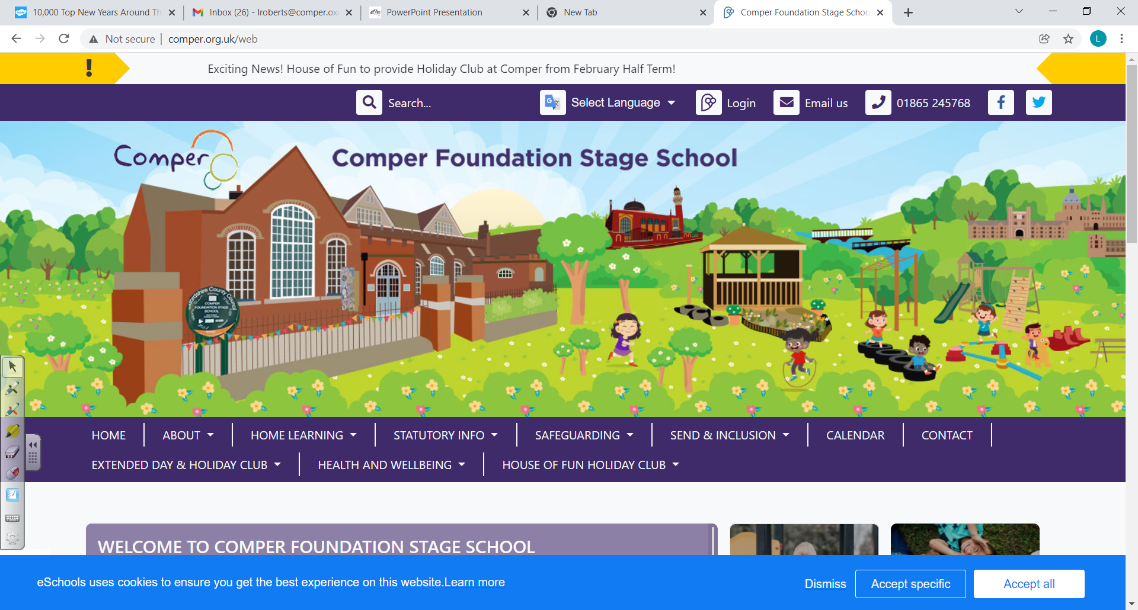

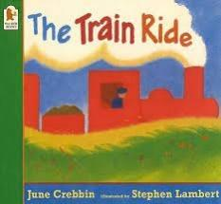

‘Journeys and Change’
Summer Term 6 - Butterflies - 2023/24
Comper Foundation Stage School- Oxford
Love Curiosity Courage Aspiration
Our Curriculum Goals
Confident Communicator, Independent Individual, Fantastic Friend, Talented Tool User, Super Story Teller, Eager Explorer
This term our focus will be Courage & Aspiration and we will be pondering the question: How does it work? Can you believe the Summer Term is almost here? Before it does we have a fun, jam packed term. Following on from our topic last term we will be putting on our adventurers backpacks and thinking about different Journeys and what transport we would use. We will also be thinking about changes not only for ourselves ‘growing up’; as we start to think about starting school and new beginnings but also how the seasons change around us as well as other things.
KEY TEXTS
Trips and Special dates
Tuesday June 11th School Class and Individual Photos
Friday 14th June Stay and Play
Library visits
11th July Trip to the local Park
Transitions (dates to follow)
Parents Evenings week beginning 8th July - 18th July
Thursday 18th July - End of year Sing-A- Long - 9.15am and 2.30pm
Friday 19th July Comper Celebration
Key songs for this term:
If You’re Happy and You Know It
1, 2 Buckle my shoe
One more step along the world I go.
Poetry Basket:
Chop, Chop
A selection of a songs will be learnt for our End of Year Sing-A-Long
Key Vocabulary
Courage
Aspiration
Transition
Anxious
Support,
Journey,
Explorer
New beginnings,
Celebrations and Festivals
Father’s day - Sunday 16th June
Eid - 16th - 20th June
Bike week - June 10th - June 16th

Slide 2
I can independently brush my teeth, use the toilet and wash and dry my hands thoroughly.
I can independently get dressed and undressed, for example, putting on coats and doing up zips.
I know how to independently meet my own personal hygiene care needs.
I know how to make healthy choices about food, drink, activity and toothbrushing.
I can answer questions and share opinions using the relevant vocabulary.
I know how to express a point of view and to debate when I disagree with an adult or a friend, using words as well as actions.
I can independently carry out self-care routines such as getting dressed and undressed, putting on my own coat and doing up zips.
I can hold a pen comfortably and use it with good control.
I know how to hold a pen using a comfortable grip
Personal, Social and Emotional Development
Communication and Language
Physical Development
Summer Term 6
‘Journeys and Change’
I can talk about and identify patterns around me. For example: stripes on clothes, designs on rugs and wallpaper. I can use informal language like ‘pointy’, ‘spotty’,
‘blobs’ etc.
I can subitise up to 3
I can to recite numbers past 5
I can say one number for each item in order: 1,2,3,4,5.
I know how to create ABAB patterns–
stick, leaf, stick, leaf.
I know how to notice and correct an error in a repeating pattern.
Area Focus: Subitising
Counting
Patterns
Colours
Shapes
Mathematics
I can write some letters accurately.
I can make predictions about a story using the relevant vocabulary.
I can mark make for a purpose and can talk about the marks I make.
I know how to write some or all of my name.
I can make up my own stories using Tales Toolkit
I can show different emotions in my drawings and paintings, like happiness and sadness.
I can play instruments with increasing control.
I can play instruments to express my feelings and ideas.
I know how to show good listening. I can listen with increased attention to sounds.
I know how to express my thoughts and feelings when responding to sounds I have heard.
Expressive Arts and Design
I can explore and talk about different forces I can feel, such as pushing different objects down in water.
I can talk about different countries in the world and the differences I have experienced or seen in photos.
I am developing positive attitudes about the differences between people.
I know that there are different countries in the world
Magnets and forces
Floating and Sinking
Literacy
Understanding of the World

