Slide 1
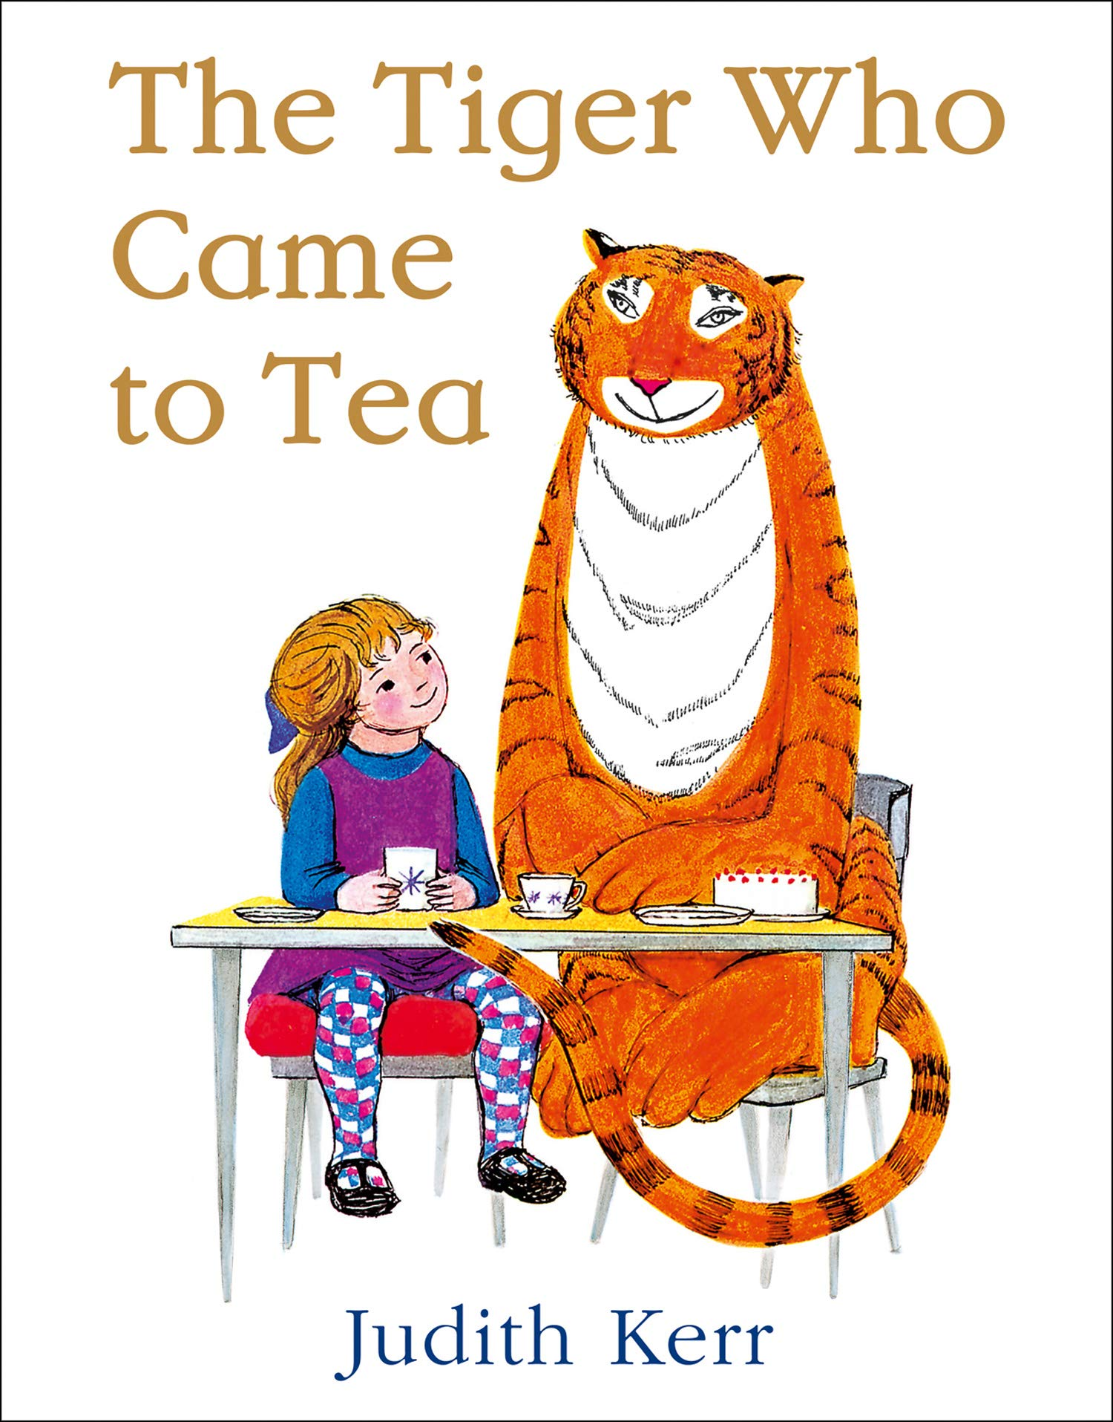
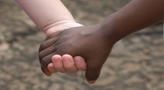
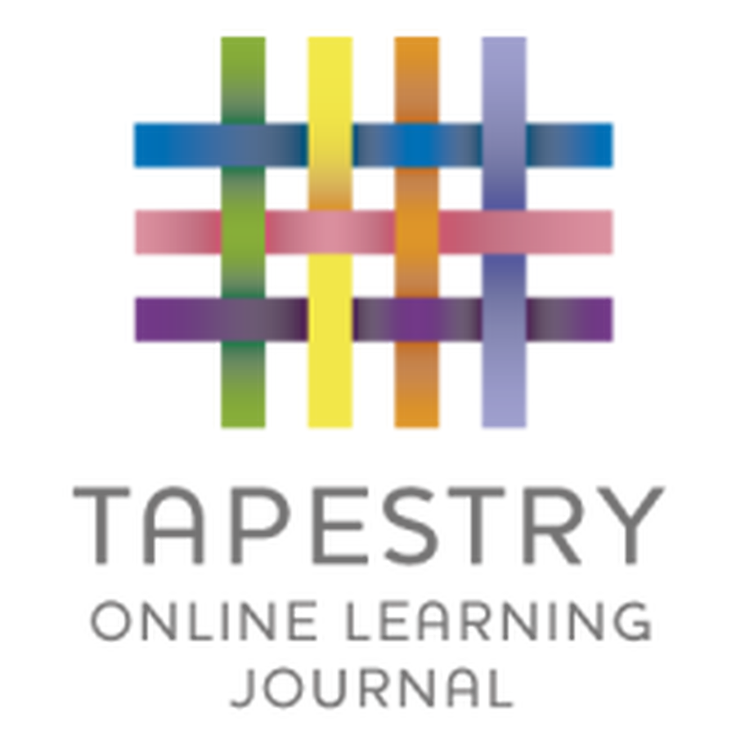
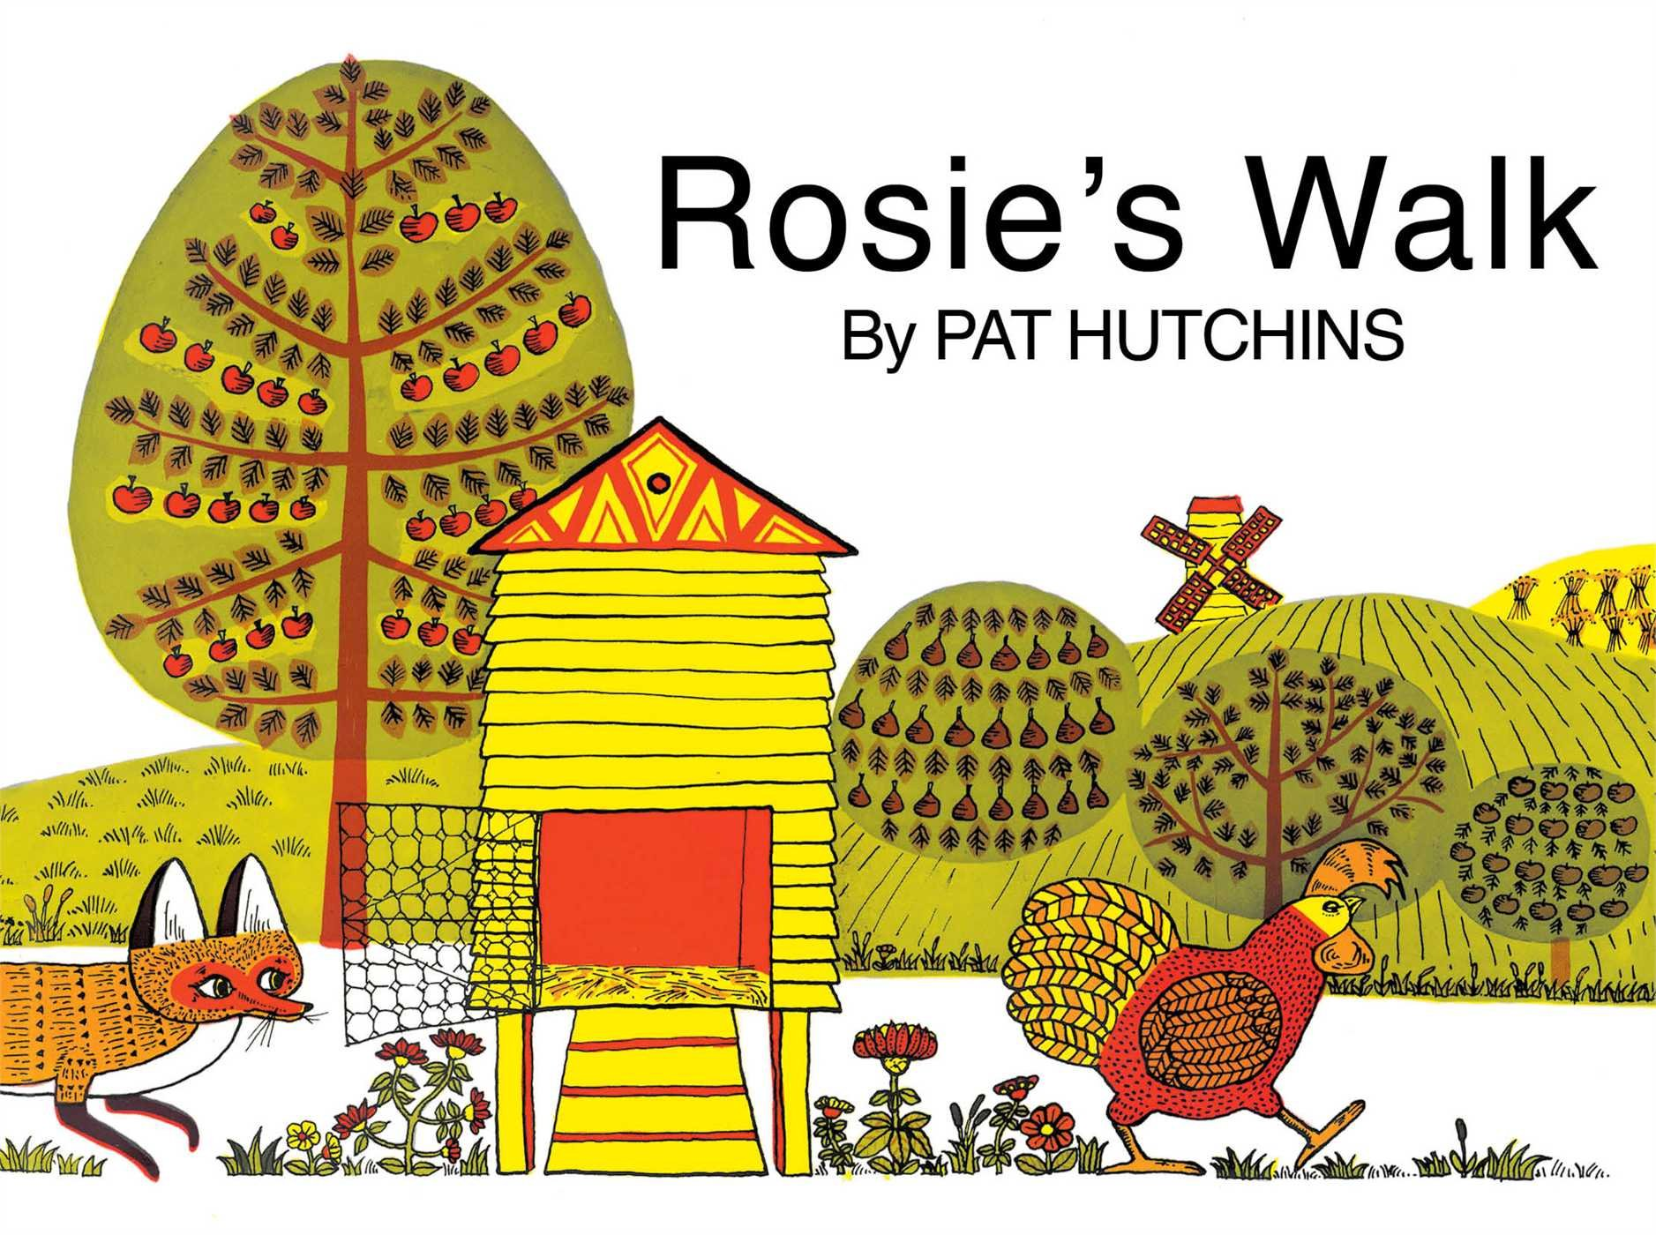
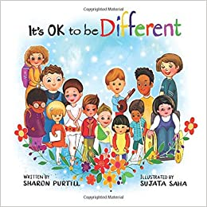
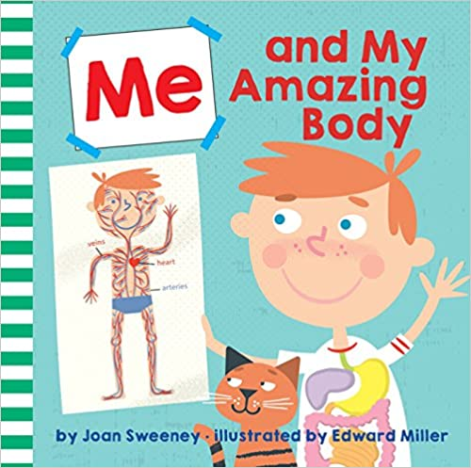
‘The World Around Us - Our Community’
Spring Term 2 - Nursery (EYFS)- 2021/22
Comper Foundation Stage School- Oxford
Love Curiosity Courage Aspiration
Welcome to Nursery at Comper Foundation Stage School!
This Spring half term is filled with so many exciting activities and experiences. Our topic will focus on a selection of key texts that will be used to support the children's learning as well as covering the key areas of learning. These well known and loved stories will immerse children in exploring the world around them.
KEY TEXTS
Tapestry is used to communicate and celebrate your child's learning and development. It is an secure online learning journal that lets you actively engage in your child's education. We really enjoy sharing with you what your child gets up to at Nursey as well as you sharing with us what your child gets up to at home!
Some of the activities we will be doing this term include:
Farmer Gows are coming to visit us! (Date TBC)
An exciting busy term celebrating: World Book Day, Science Week, Mother’s Day, Autism Awareness Week as well as Holi the Hindu festival of colours and Comic relief.
Getting out into our community!
Finding out about our bodies
Discussing keeping safe
Finding out about people who help us

Slide 2
A key aspect of our role is to provide experiences and support that will enable children to develop a positive sense of themselves and of others.
Recognising that all feelings are normal and valued we will support the children to manage their feelings as well as learning how to use coping strategies to self-regulate their emotions and adapt their behaviour through using role- play, puppets and persona dolls. We will be discussing and sharing our thoughts on how we are similar/ different to each other as well as working together playing team building games such as crossing the river.
Using the key texts such as The Tiger who came to tea by Judith Ker Children will have the opportunity to explore the content and key vocabulary through discussions in circle time and by using visuals, props and songs to support and encourage the children's communication and language development. Children will learn how to retell the story
Physical development is vital for the all- round development of both gross and fine motor skills. We will be learning about our bodies and will be exploring ways of moving such as slithering, crawling, rolling as well as taking part in obstacle courses focusing on traveling with confidence and skill around, under and over balancing equipment retelling Rosie's Walk story book. We will also be testing how many hops, jumps, squats we can do in a minute as well as doing yoga.
Personal, Social and Emotional Development
Communication and Language
Physical Development
Key songs for this term: Old McDonald, If your’re happy and you know it and Finger Family song of people who help us!
This term we will be exploring our key chosen texts and will be enjoying both non-fiction books about our bodies as well as fiction books such as The tiger who came to tea. We will be exploring the key vocabulary as well as discussing what we have read and describing the characters. Through exploring our community we will be creating texts to communicate meaning for a range of purposes such as shopping lists.
Following on from our previous learning in mathematics we will be continuing to be able to count up to 5 or 10 as well as matching the corresponding numerals.
We will be exploring shape, space and measure through creating colourful
patterns for Holi Festival and
developing our spatial awareness language to be able to give directions to each other drawing from the vocabulary used in Rosie's walk as well as making maps of our environment and
measuring with a timer.
Within Understanding the World we celebrate the children of our community while also making sense of the world around us. We celebrate what makes children unique and respect individual wishes and believes. Using this terms key texts we will be acknowledging and respecting our differences and similarities as well as exploring our uniqueness. We will be thinking about our community and discussing the people around us who help us.
Throughout our topic we will be supporting children to use their imagination and get creative. We will use props to support understanding storytelling and singing. And we will have weekly focused creative actives. We will be exploring patterns and mixing colours for Holi the Hindu festival of Colours as well as creating maps of our environment.
Literacy
Mathematics
Understanding of the World
Expressive Arts and Design

