Slide 1
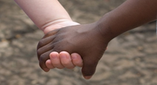
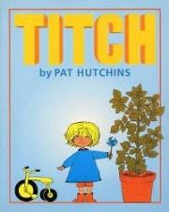
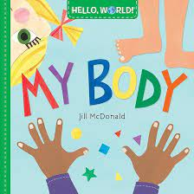
Key texts this term
Growing and Changing
Caterpillars Spring Term 4
Love Curiosity Courage Aspiration
Our key vocabulary this term is:
changes, growing, family, measure, Spring bigger/smaller
Green fingers at the ready for this term! Spring is just around the corner and signs of life are popping up all around us. We will be exploring and investigating mother nature, observing how plants grow from seeds, looking at ourselves and how we grow.
Our value this term is: Curiosity
This term we will be talking about and celebrating:
Mothers day Stay and Play Friday 8th March
Mother’s day - 10th March
World Book Day- Thursday 7th March
Ramadan - 10th March
Comic Relief Friday 15th March
Key songs and rhymes:
Baa Baa Black sheep
Pop goes the Weasel
There’s a tiny caterpillar on a leaf
Staff continue to use Tapestry to communicate and celebrate your child's learning and development. Please let a member of staff know if you need any support with this.
Special events this term include:
Parents consultations week beginning 18th - 22nd March
Parents invited to bring baby sibling for the children to ask questions related to Growing and Changing Topic
School Term ends Thursday 28th March

Slide 2
We will be:
Exploring and naming our feelings.
Discussing food we like/ dislike to eat linked to our story of the Hungry Caterpillar.
Exploring turn taking with a range of games and activities.
Talking about growing: linking to the life cycle: parents to bring babies in?
We will be:
Developing our balls skills.
Continuing to developing independence with self-care such as washing hands before meals, after toileting.
Support independence with dressing.
Exploring different foods and focusing on foods that are good for us to eat.
We will be:
Carrying out a range of listening and attention games in small groups.
Exploring and developing language skills and vocabulary through the core texts.
Learn different makaton signs that link to growth and change - flower, big, small, baby, bottle, milk, and nappy.
Personal, Social and Emotional Development
Physical Development
Communication and Language
Growing and Changing
Spring Term 4
We will be: -
Using spatial and positional language
Measuring objects/plants.
Noticing how many objects there are in a group.
Supporting children to notice when there is more/less of something.
Using the language of comparison when exploring our environment - bigger, smaller etc.
Mathematics
We will be:
Inviting baby siblings in to visit.
Planting seeds and caring for plants and things that are growing in our garden.
Exploring how we take care of our environment.
Observing changes in our immediate environment and talking about them.
We will be:
Playing musical instruments.
Making our own instruments with a variety of materials.
Learning actions and lyrics to songs and rhymes.
Joining in with singing, dancing and music and movement activities.
We will be:
Creating magic marks using crayons and watercolours.
Sequencing and retelling key parts of well known stories.
Exploring Tales Toolkit in small groups and developing our understanding of characters and events in stories.
Developing our use of story language.
Understanding the World
Expressive Arts and Design
Literacy

